Slide 1
UNIT II
MASTERING COMMUNICATION SKILLS
Slide 1.

Slide 2

Slide 2.

Slide 3
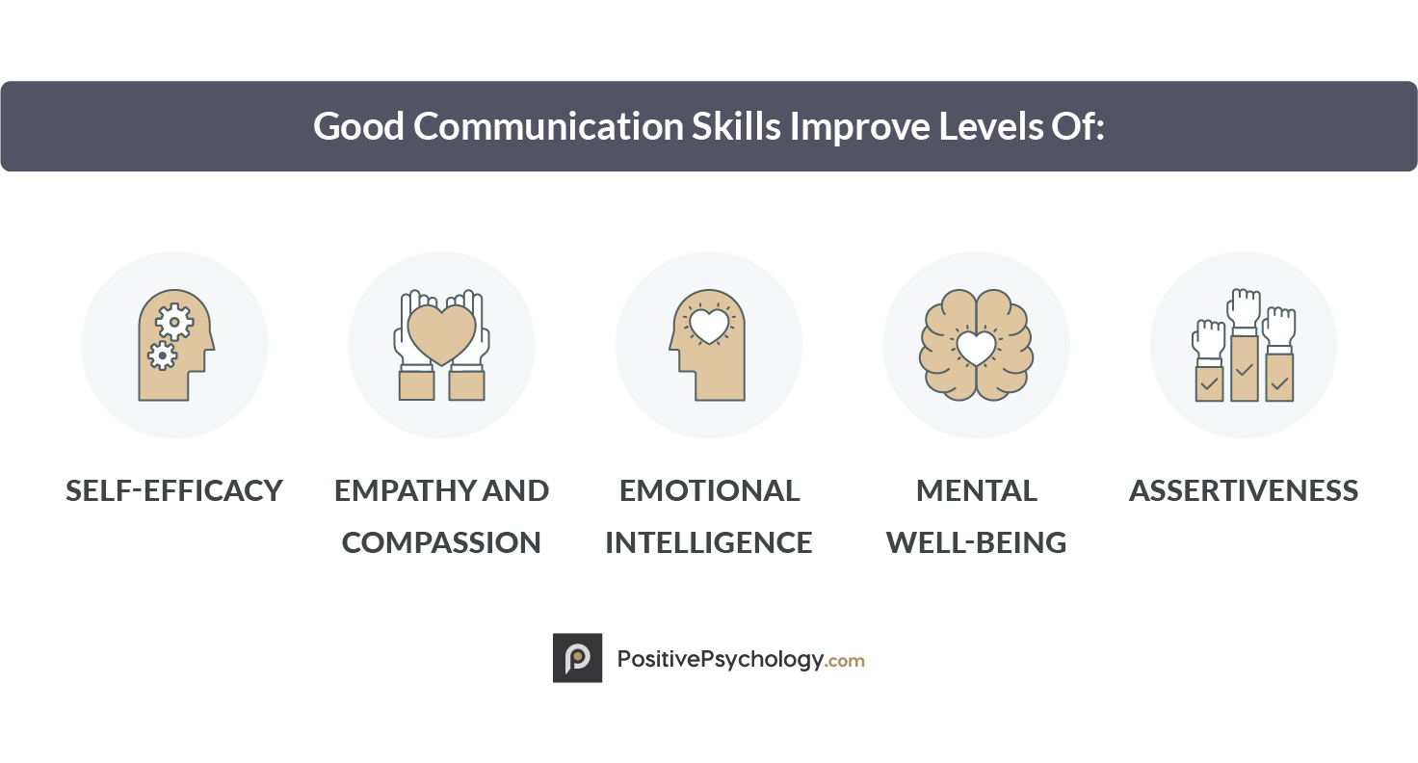
Slide 3.

Slide 4
Poll 1. Communication is a part of __________ skills.
Hard
Soft
Rough
Short
Slide 4.

Slide 5
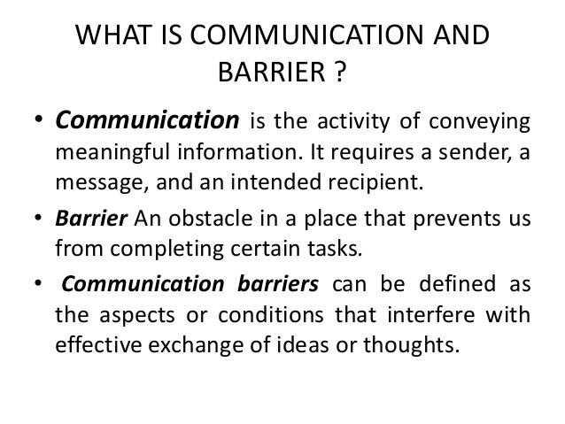
5.
Slide 5.

Slide 6
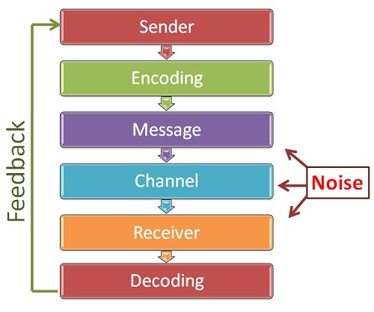
Slide 6.

Slide 7
Poll 2. The ________ is the person who transmits the message.
Receiver
Driver
Sender
Cleaner
Slide 7.

Slide 8

Role play
Two friends discussing about their upcoming project.
Slide 8.

Slide 9
Role play
Two friends meeting after long time. One is already working in Microsoft, other is looking for job.
Slide 9.

Slide 10
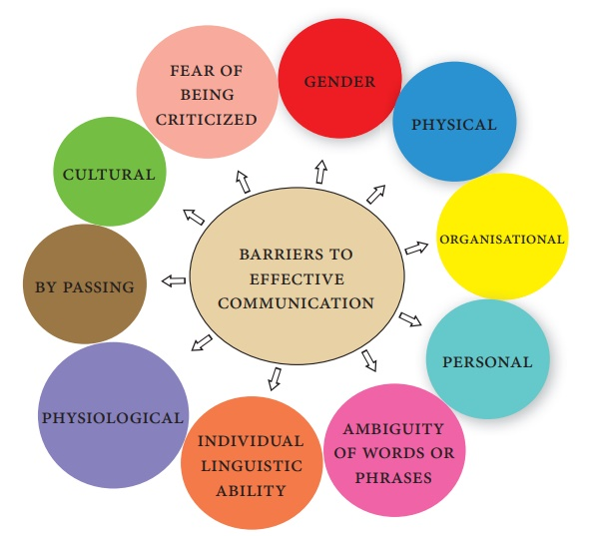
Slide 10.

Slide 11
Poll 3. Communication strengthens ______________ & _____________ relationship in an organization.
Employer-Father
Employer-Employee
Mother-Child
Slide 11.

Slide 12
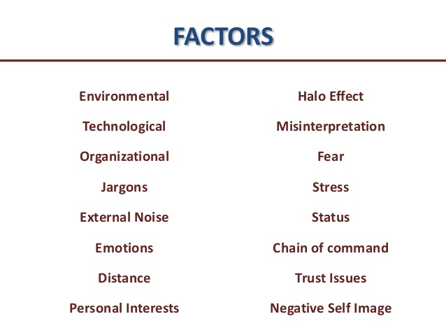
Slide 12.

Slide 13
Role play
Seeking career advice from senior.
Slide 13.

Slide 14
Role play
Food ordered wrong in a restaurant.
Slide 14.

Slide 15
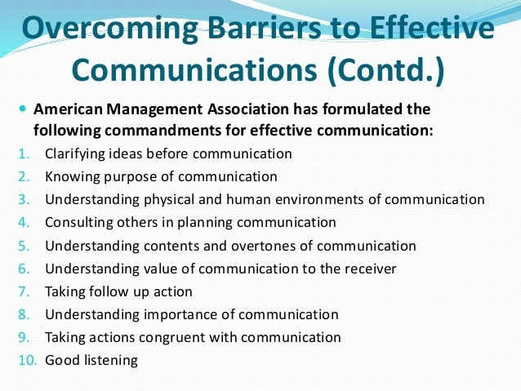
How to overcome these barriers:
Slide 15.

Slide 16
Poll 4. While talking to your friends, you do not pay attention to the _____________ skills of your friend.
Written
Oral
Audio
Visual
Slide 16.

Slide 17

Picture perception
Slide 17.

Slide 18

Picture perception
Slide 18.

Slide 19
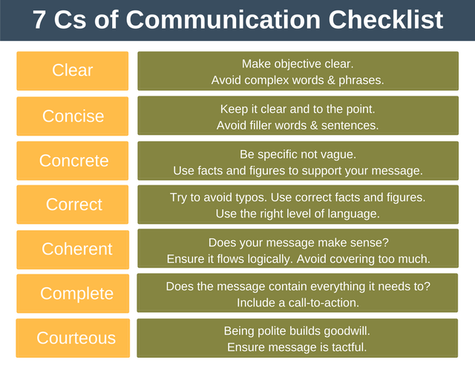
Slide 19.

Slide 20
Poll 5. While communicating, one should always tailor the conversation….
as per ones own needs
considering listener
Slide 20.

Slide 21
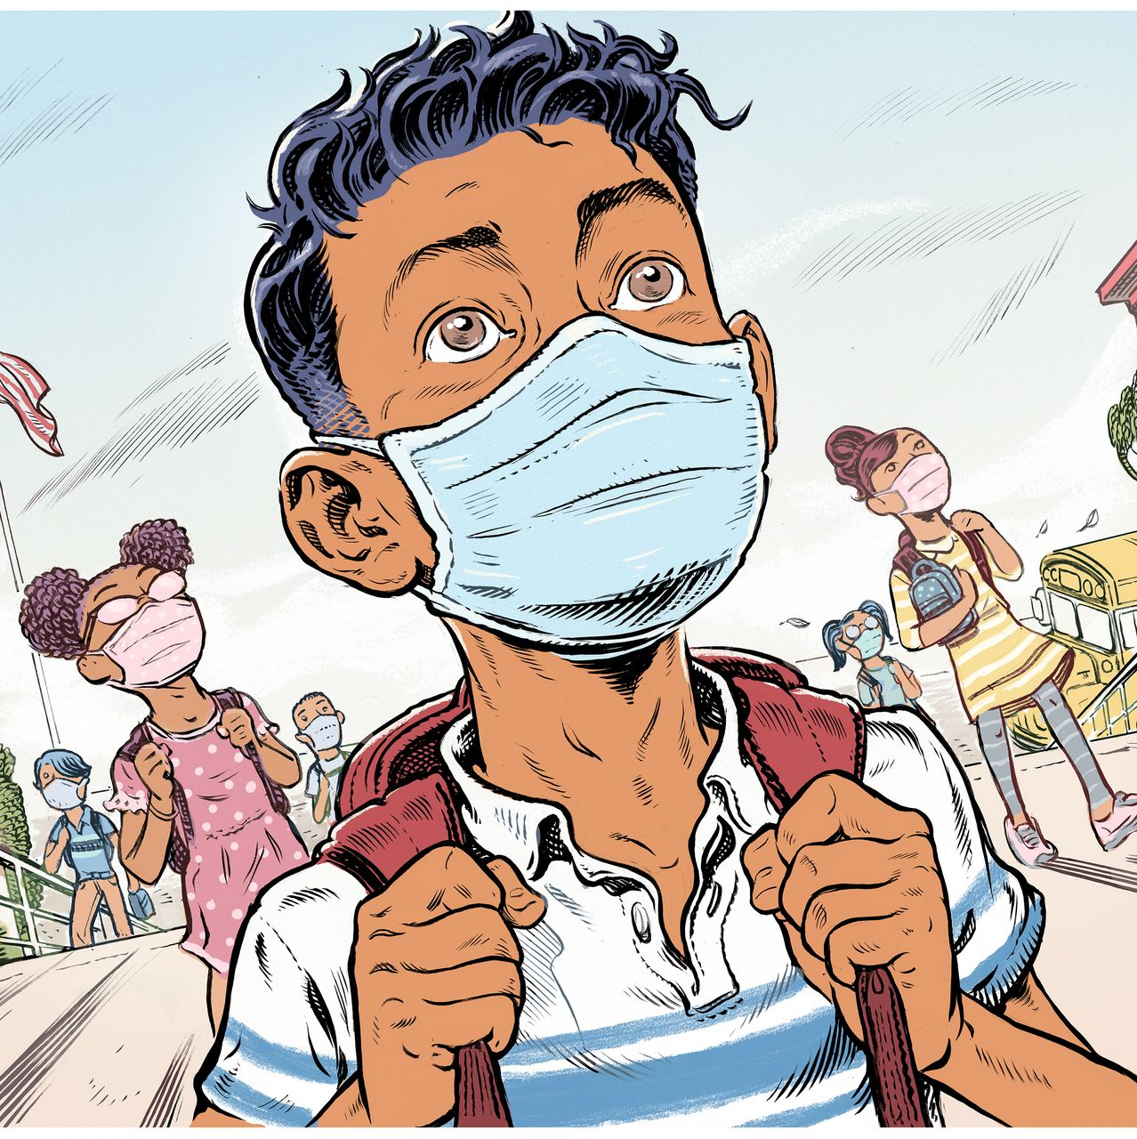
Picture perception
Slide 21.

Slide 22

Picture perception
Slide 22.

Slide 23
Slide 24.

Slide 24
Poll 6. To be a good communicator, one does not need to speak but spectate others speaking.
Yes
No
Slide 25.

Slide 25
Slide 26.

Slide 26
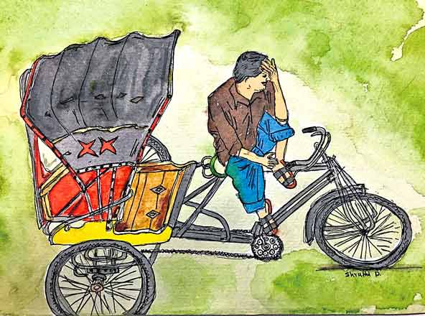
Picture perception
Slide 27.

Slide 27

Picture perception
Slide 28.

Slide 28
Vocab:
Prospects:opportunity for success, promotion etc.
Personnel: the people who work for a firm.
Slide 29.

Slide 29
Idioms
Meaning
Idioms
No-brainer | Something that is really obvious or easy | Making money working for an investment bank is a no-brainer.
The elephant in the room | An obvious problem or controversial issue that no one wants to discuss. | We should have discussed our pending litigation, but no one wanted to talk about the elephant in the room.
Slide 30.

Slide 30

Slide 31.

Slide 31

Slide 32.

